Slide 1
Framework for Multidisciplinary Optimization
M Vishnu Sankar (18B030013)
Prof. Abhijit Gogulapati

Slide 2

Contents
Deliverables
Problem Overview – Expected from this report
Features and Philosophy
Implementing and Testing
Live Demo
Future Work

Slide 3
Deliverables and Problem Definition
Deliverables
A framework to integrate any number of disciplines
Communicate seamlessly with different analysis tools
Predicts an optima or a set of optima
Problem Definition – Stage 01
Theoretical structure for the seamless interfacing
Test it by actual implementation
Notes:
Deliverables
A robust framework that's versatile to integrate any number of disciplines
Communicate seamlessly with different analysis tools
Predicts an optima or a set of optima which are better than baseline design
Problem Definition
Theoretical structure for the seamless interfacing of different solvers/analysis tools
Test it by actual implementation

Slide 4
Key Features and Philosophy
Solver Agnostic
Simple plug and run with any solver
Treat analysis tools as black boxes
Modularity
Integrate additional disciplines without modification
Building on top of each other
Simplicity
User need not work with more than 2 files at most
Scalability & Flexibility
Scaling to thousands of design variables should be feasible
Efficient Gradient Evaluation
Offer different methods to compute gradients efficiently
Goals of this Project
Leverage OpenMDAO* [1]
Notes:
Solver Agnostic
Simple plug and run capability for any analysis tools with very minimal changes to the framework
Treats analysis tools as a black box
Modularity
Integrate additional disciplines without modifying other discipline structure
Building on top of each other
Simplicity
User need not work with more than at most 2 files
Scalability & Flexibility
Scaling to thousands of design variables should be feasible
Efficient Gradient Evaluation
Offer different methods to compute gradients efficiently

Slide 5
Key Challenges
#01 Number of Unknowns is Unknown
Dimension of the problem
Key decision: Disciplines need to be pre-embedded as modules
Drawback: Adding new disciplines needs some work
Advantage: Code structure remains similar across disciplines
#02 Solver Interface
Framework works independent of the solver used – Solver Agnostic: Plug and Run feature
Modularity!
Any independent task with a specific goal is treated as a module
Changing one module does not affect the other
Easy debugging
Notes:
#01 Number of Unknowns is Unknown
Dimension of the problem – design variables, objective functions, constraint equations, number of disciplines involved
Key decision: Disciplines need to be pre-built as modules
Drawback: Adding new disciplines needs some work, but the code structure remains similar across disciplines. So adding a new discipline is not doing all the work from ground 0
#02 Solver Interface
Framework works independent of the solver used – Solver Agnostic: Plug and Run feature
Modularity!
Any independent task with a specific goal is treated as a module
Changing one module does not affect the other
Easy debugging

Slide 6

Architecture of the Framework

Slide 7
Architecture of the Framework
OUT FLOW PROCESSOR
DISCIPLINE MANAGER
OPENMDAO
OUTPUT FILES
Note:
Arrow heads indicate direction of process
Flow of data is assumed to be along the arrow heads direction unless stated otherwise
IN FLOW PROCESSOR
Notes:
For four key tasks are identified
1. Optimization
2. User interface
3. Outflow Processor – Responsible for processing and managing all the analysis
4. Inflow Processor – Responsible for evaluating and fetching all the design variables, obj functions, constraints

Slide 8
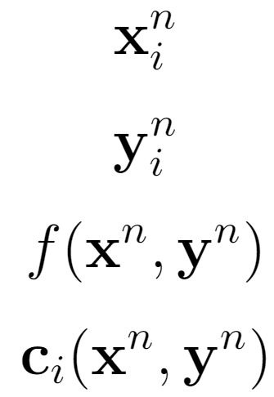
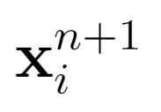
OpenMDAO
OPENMDAO
D1
OPTIMIZER
D2
INPUT
OUTPUT
.
.
.
MODULE MANAGER
Dn
Notes:
Module Manager: Receives the input as vectors, the design variables are classified on the basis of their disciplines and sent to the discipline module. Module manager is the primary tool that inputs as well as outputs the necessary information from OpenMDAO to the discipline manager.

Slide 9
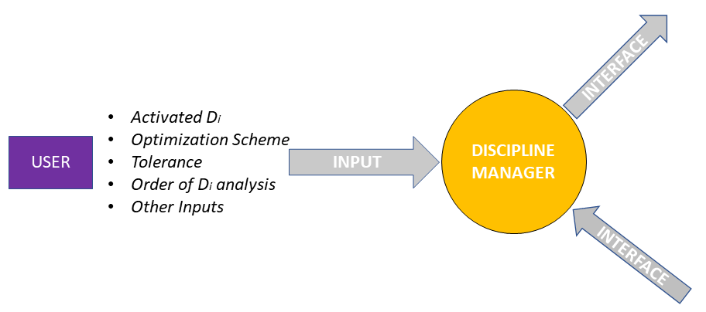
Discipline Manager

Slide 10
Outflow Processor
OUT FLOW PROCESSOR
OUT FLOW MANAGER
INPUT
Di
IP/OP
Di
API
Di
SOLVER
OUTPUT FILES

Slide 11
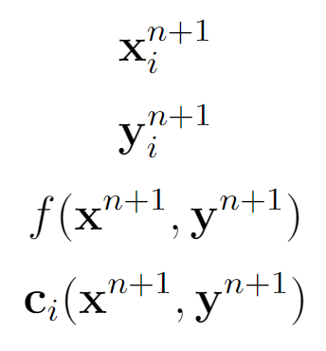
Inflow Processor
OUTPUT FILES
OUT FLOW PROCESSOR
IN FLOW PROCESSOR
Execution command
OUTPUT
IN FLOW PROCESSOR
IN FLOW MANAGER
COLLECTOR
Di
CALCULATOR
OUTPUT FILES
Di
PROCESSOR
FLOW OF DATA

Slide 12
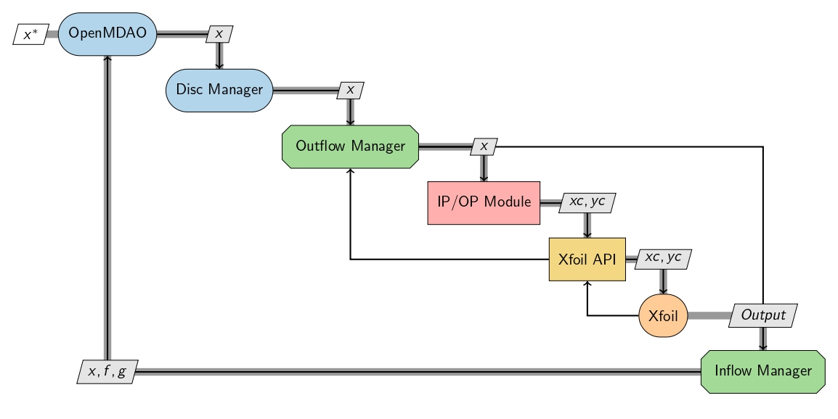
Implementing the Framework: Xfoil

Slide 13
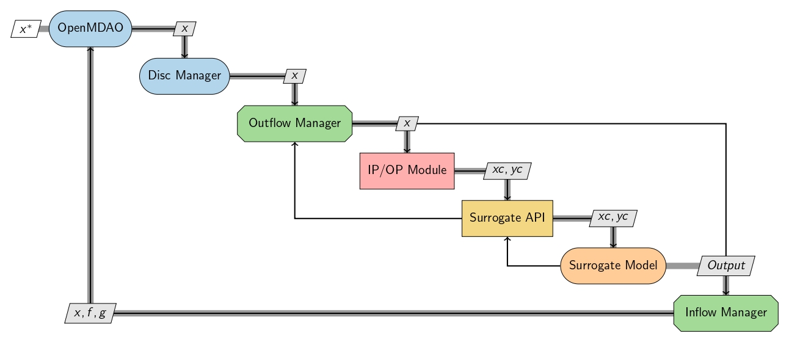
Implementing the Framework: Surrogate

Slide 14
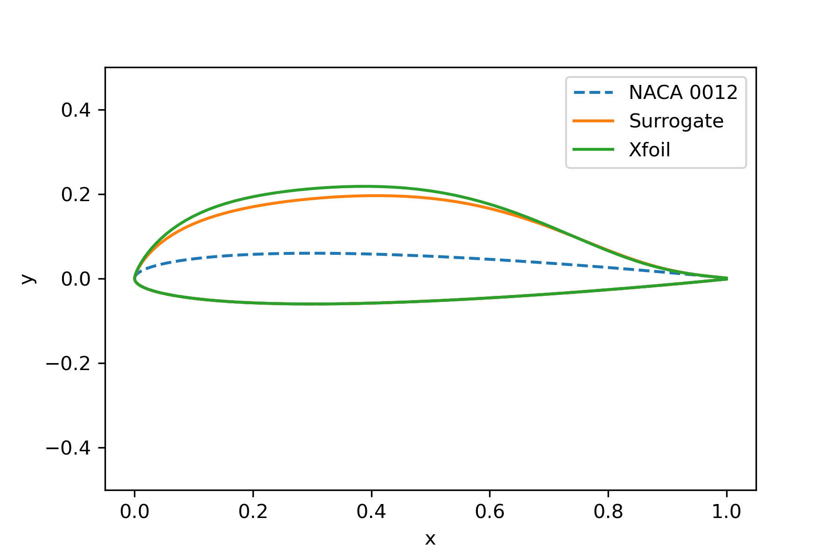
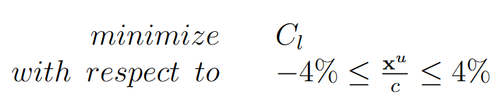
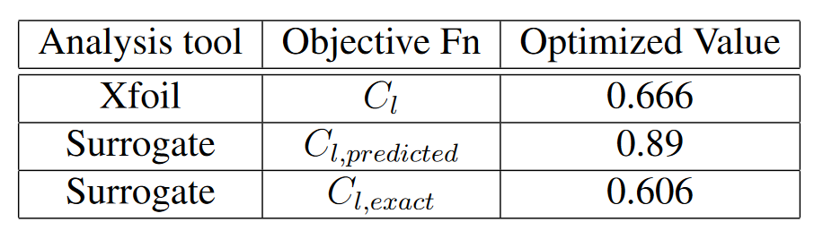
Testing and Results
Unconstrained Problem

Slide 15
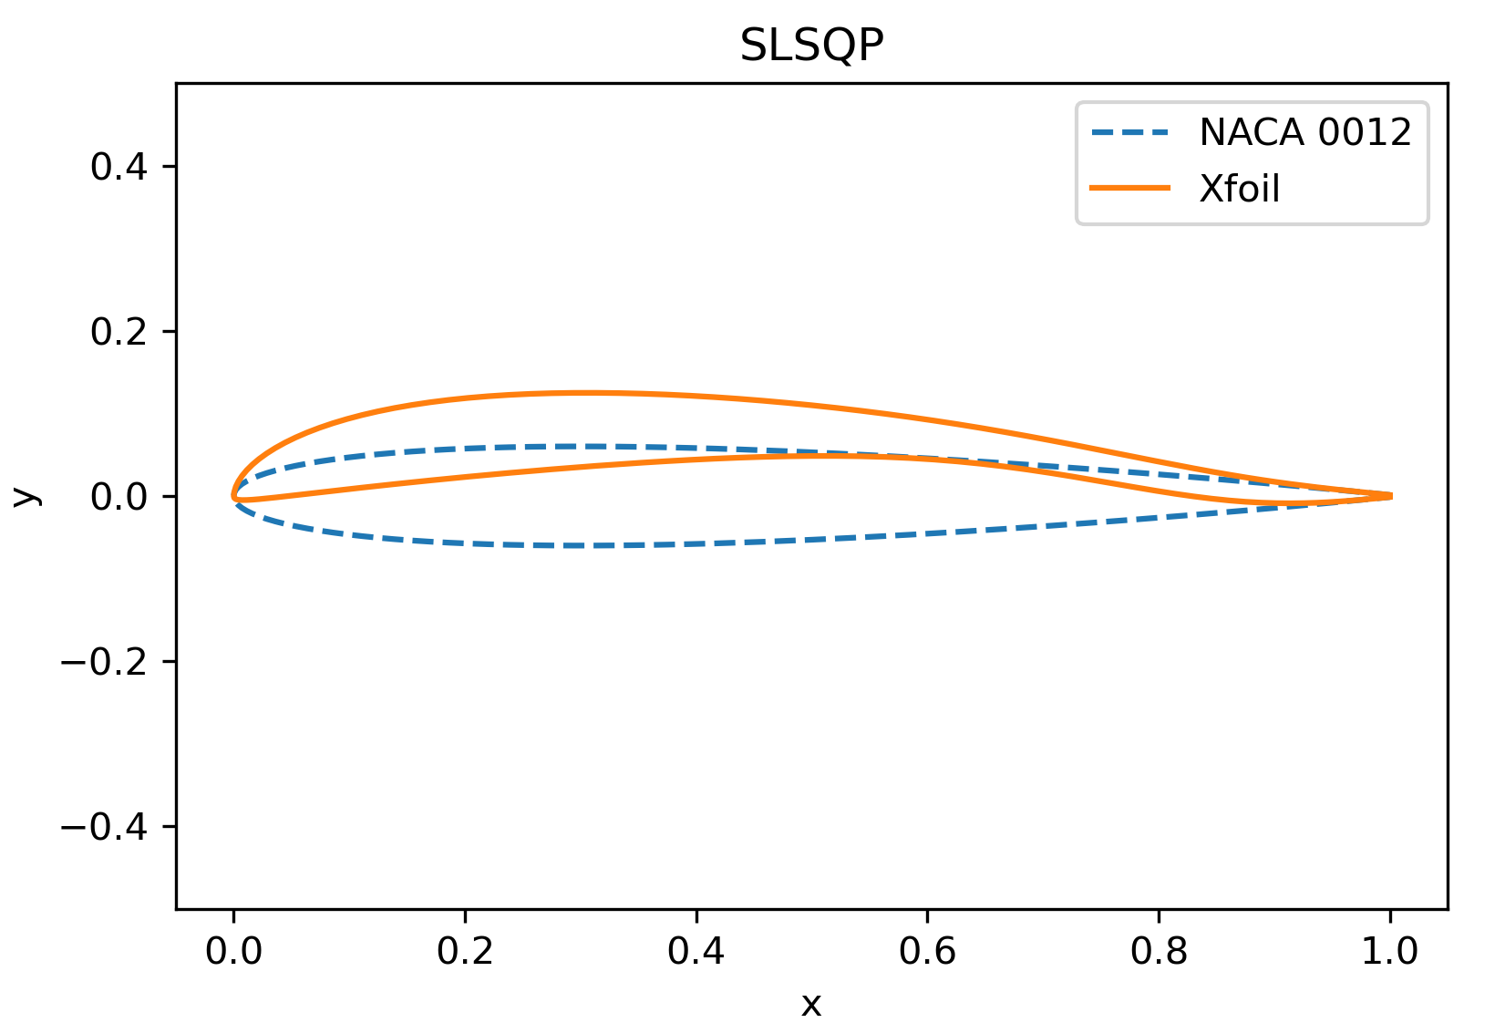
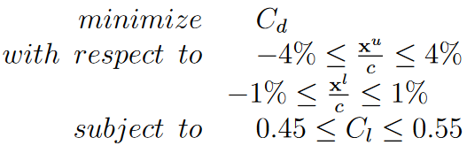
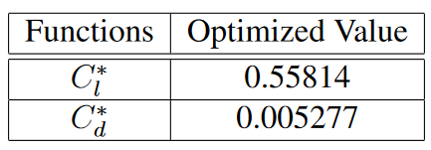
Testing and Results
Constrained Problem

Slide 16
Future Work
Framework has been developed and tested for a 2D aerodynamics problem
Goals:
1. Develop the framework to integrate another discipline, RCS module 2. Optimize & Validate the 2D airfoil with RCS module
3. Optimize & validate a 3D wing with only aerodynamics
4. Optimize & Validate a 3D wing with aerodynamics and RCS 5. Optimize a 3D wing with atleast two disciplines coupled with each other
6. Add other disciplines one by one on top of the existing framework

Slide 17

Live Demo

Slide 18
References
[1] Justin S Gray, John T Hwang, Joaquim RRA Martins, Kenneth T Moore, and Bret A Naylor. Openmdao: An open-source framework for multidisciplinary design, analysis, and optimization. Structural and Multidisciplinary Optimization

Slide 19

Appendix

Slide 20
Training Surrogate Model
Take N airfoils, keep increasing N until error convergence is achieved
Then fix N, change training data set % until error convergence is achieved

Slide 21
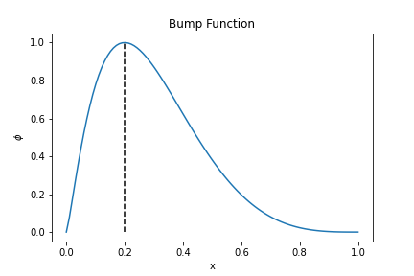
Parameterization
Hicks-Henne Bump Function

